Slide 1






1ˢᵗ IEEE Uttar Pradesh Section Women in Engineering
International Conference on Electrical Electronics and Computer Engineering
Paper ID: 403
Title: Pre-Owned Car Price Prediction via Cross-Validated Meta-Ensembles and Feature Composites.
Presenter Name : Garikapati Aishwarya
Affiliation : JNTUK

Slide 2
Contents
1. Introduction and Brief Review
2. Methodology
3. Experimental Setup
4. Result and Discussion
5. Conclusion

Slide 3

INTRODUCTION
BRIEF REVIEW
  Predicting used car resale prices in India is challenging due to diverse, non-linear vehicle attributes.
  Traditional methods rely on manual estimation and fixed depreciation rules, often inaccurate and inconsistent.
  Objective: Develop a machine learning-based regression model for precise, data-driven price forecasting.
  Used a Kaggle dataset usedcars.csv (5,000+ car listings) and deployed results through a Flask web application for real-time valuation.
  Linear Regression models were initially used but struggle with non-linear automotive data.
  Random Forest and Gradient Boosting (XGBoost, CatBoost) showed higher accuracy and robustness.
  Ensemble learning further improved R² scores and reduced errors (Chatterjee et al., 2024).
  However, most prior work focused on global datasets—few adapted models to Indian market dynamics.

Slide 4
METHODOLOGY
1) Data Source & Preprocessing:
  Used a Kaggle dataset of 5,000+ Indian used cars. Cleaned data by removing outliers (IQR method), converting categorical fields, and engineering new features like price per km and horsepower-to-age ratio.
2) Feature Engineering:
  Created domain-specific composite features—brand-wise average price, normalized horsepower, and vehicle age—to capture real market dynamics.
3) Model Development:
  Trained multiple regression models — Decision Tree, Random Forest, XGBoost, CatBoost, AdaBoost, and a Stacked Ensemble (Ridge + XGBoost + LightGBM).
  Applied Grid Search and K-Fold Cross Validation for tuning and stability.
4) Deployment:
  Integrated the final model into a Flask-based web app for real-time car price prediction, enabling use by dealers, fintechs, and online marketplaces.

Slide 5
EXPERIMENTAL SETUP
  Environment & Tools: Python 3.10 (Google Colab) with Scikit-learn, XGBoost, CatBoost, LightGBM, Pandas, NumPy, and Matplotlib.
  Data Split & Validation: 80:20 train–test ratio with 5-fold cross-validation for model stability and tuning.
  Preprocessing: Outlier removal (IQR method), log1p price transformation, numeric conversion for mileage/engine, label encoding, and standard scaling.
  Feature Pipeline: Derived features such as price/km, horsepower-to-age ratio, brand average price, and vehicle age processed via ColumnTransformer and Pipeline.
  Model Tuning & Training: Hyperparameters optimized through Grid Search and early stopping for boosting models; best model selected using CV R² and RMSE.
  Evaluation & Validation: Metrics used — R², RMSE, MAE, and MAPE; validated on 150 unseen examples (91.5% within ±20%).
  Hardware & Reproducibility: Executed on Colab (GPU enabled) with fixed random seed and environment versioning for reproducibility.

Slide 6
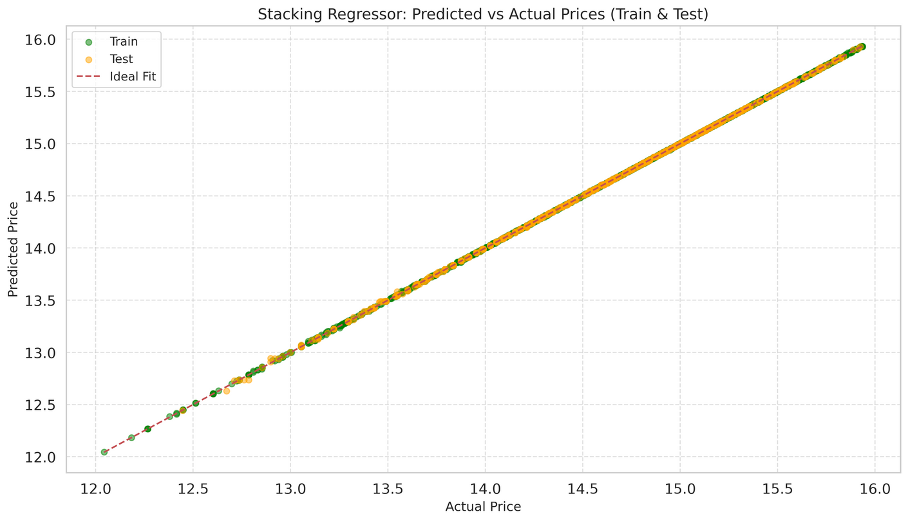
RESULTS & DISCUSSIONS
  Model Comparison:
    Six regressors were tested - Decision Tree, Random Forest, AdaBoost, XGBoost, CatBoost, and Stacking Ensemble.
    The Stacking Regressor (Ridge + XGBoost + LightGBM) delivered the best performance across all metrics.
  Performance Metrics:
    R² = 0.9886
    RMSE = 1.79
    MAE = 0.90
    MAPE = 0.12
  Key Insights:
    Brand, mileage, horsepower, and vehicle age were top predictors of price.
    CatBoost individually performed strongly (R² = 0.9848) but was outperformed by the stacked ensemble.
    91.5 % of unseen samples were predicted within ±20 % of actual price, confirming model generalization.
  Interpretation:
    The ensemble captured both linear and non-linear market trends, outperforming standalone models and traditional valuation methods.
    It provides a reliable, scalable solution for real-time used-car price forecasting in the Indian market.
fig: Train vs Test Graph for Stacking Ensemble

Slide 7
CONCLUSION
  Proposed a machine learning-based framework for accurate used car price prediction in the Indian market.
  The stacked ensemble (Ridge + XGBoost + LightGBM) achieved superior performance with near 99% accuracy (R² = 0.9886).
  Feature engineering - including price-per-km, horsepower-to-age ratio, and brand averages - enhanced interpretability and precision.
  The model effectively captures non-linear market behavior, outperforming traditional regression and single ML models.
  Future work: extend to image and text-based data for deeper contextual understanding of car valuation.

